Slide 1
Excel Tutorial 4 Working with Charts and Graphics

Slide 2
Objectives
Create an embedded chart
Work with chart titles and legends
Create and format a pie chart
Work with 3D charts
Create and format a column chart

Slide 3
Objectives
Create and format a line chart
Use custom formatting with chart axes
Work with tick marks and scale values
Create and format a combined chart
Insert and format a graphic shape
Create a chart sheet

Slide 4
Creating Charts
A chart, or graph, is a visual representation of a set of data
Select the data source with the range of data you want to chart
In the Charts group on the Insert tab, click a chart type, and then click a chart subtype in the Chart gallery
In the Location group on the Chart Tools Design tab, click the Move Chart button to place the chart in a chart sheet or embed it into a worksheet

Slide 5
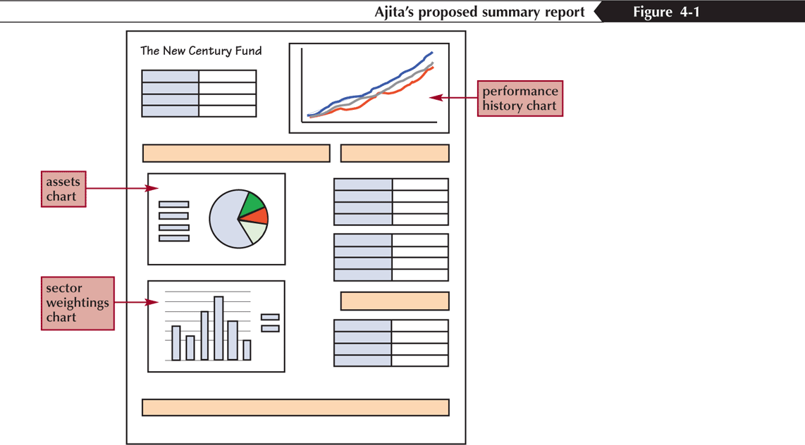
Creating Charts

Slide 6
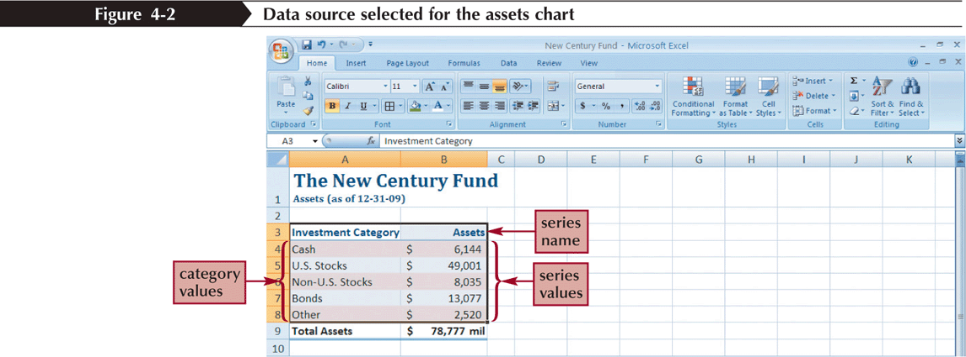
Selecting a Data Source
The data source is the range that contains the data you want to display in the chart
Data series
Series name
Series values
Category values

Slide 7
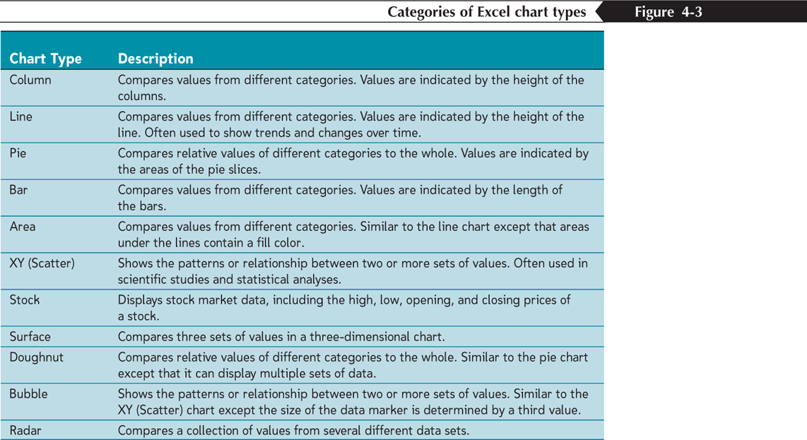
Selecting a Chart Type

Slide 8
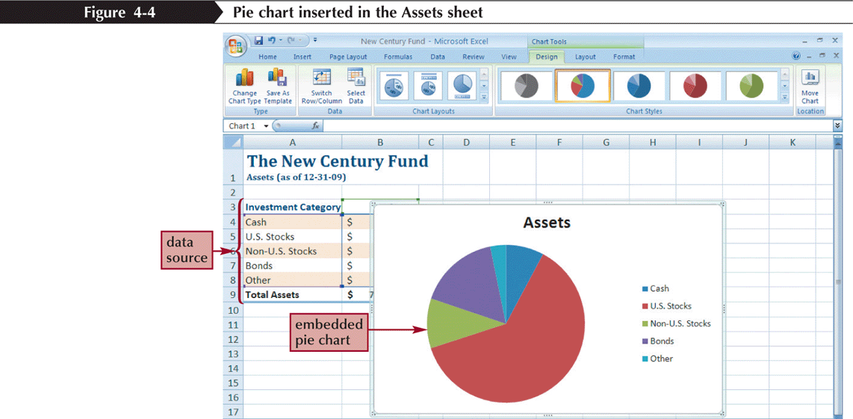
Selecting a Chart Type
Click the Insert tab on the Ribbon
In the Charts group, click the Pie button

Slide 9
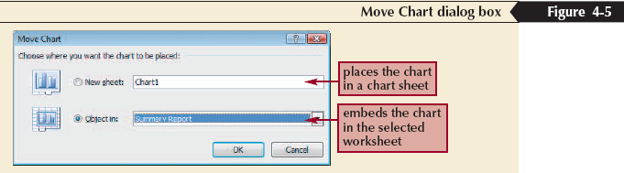
Moving and Resizing Charts
By default, a chart is inserted as an embedded chart, which means the chart is placed in a worksheet next to its data source
You can also place a chart in a chart sheet
In the Location group on the Chart Tools Design tab, click the Move Chart button

Slide 10
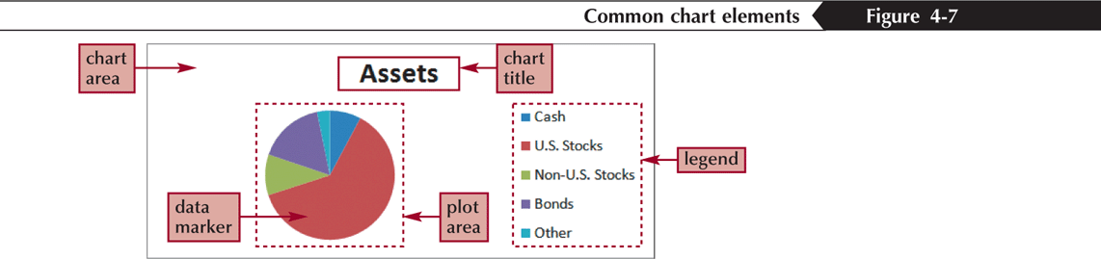
Selecting Chart Elements

Slide 11
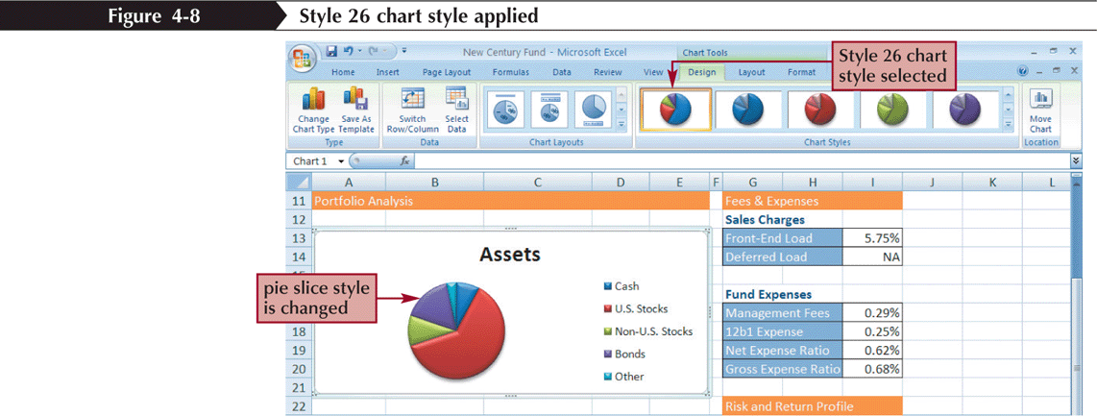
Choosing a Chart Style and Layout

Slide 12
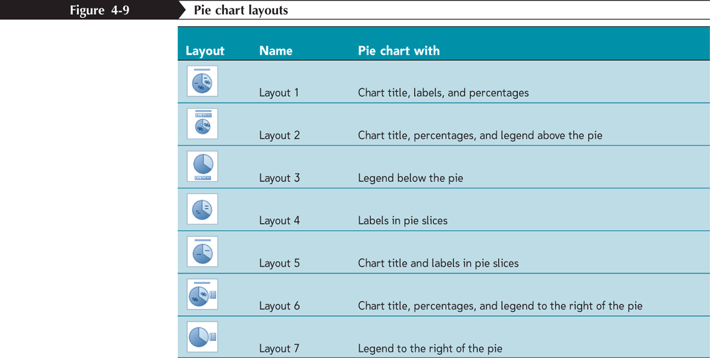
Choosing a Chart Style and Layout

Slide 13
Working with the Chart Title and Legend
Click the chart title to select it
Type the chart title, and then press the Enter key
Click the Chart Tools Layout tab on the Ribbon
In the Labels group, click the Legend button, and then click the desired legend position

Slide 14
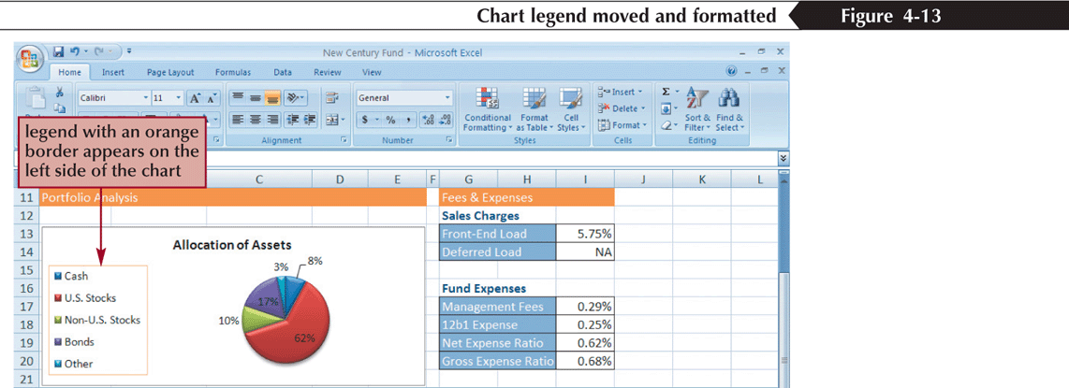
Working with the Chart Title and Legend

Slide 15
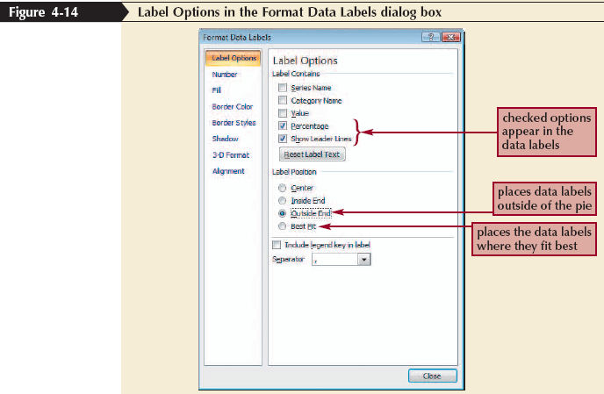
Formatting a Pie Chart
Click the chart to select it
In the Labels group on the Chart Tools Layout tab, click the Data Labels button, and then click More Data Label Options

Slide 16
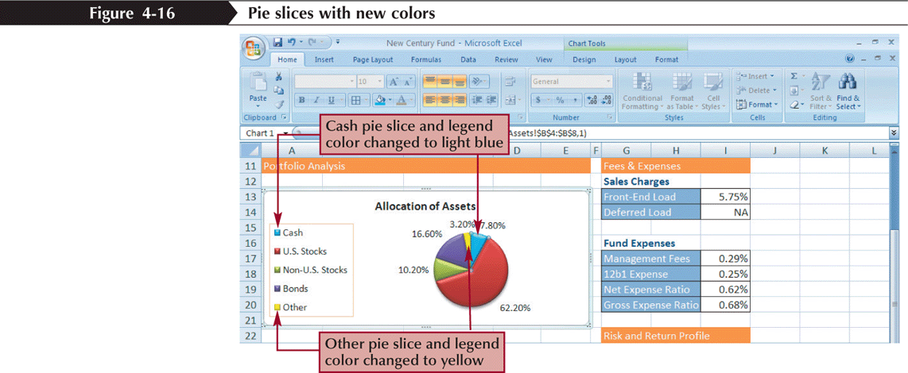
Setting the Pie Slice Colors
In pie charts with legends, it’s best to make the slice colors as distinct as possible to avoid confusion
Click the pie to select the entire data series, and then click the slice you wish to change
Change the fill color

Slide 17
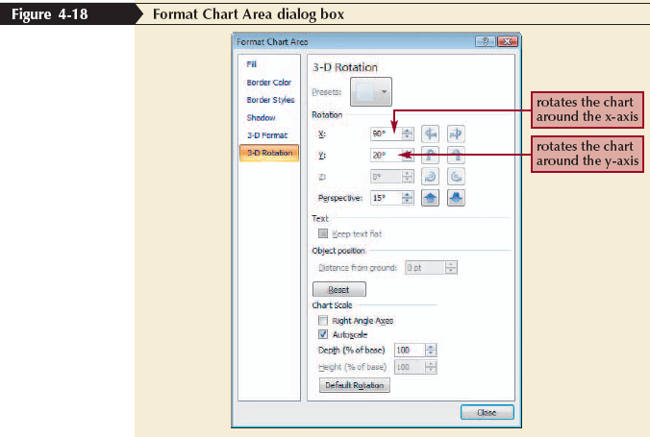
Working with 3D Options
To increase the 3D effect, you need to rotate the chart
Click the Chart Tools Layout tab on the Ribbon, and then, in the Background group, click the 3-D Rotation button

Slide 18
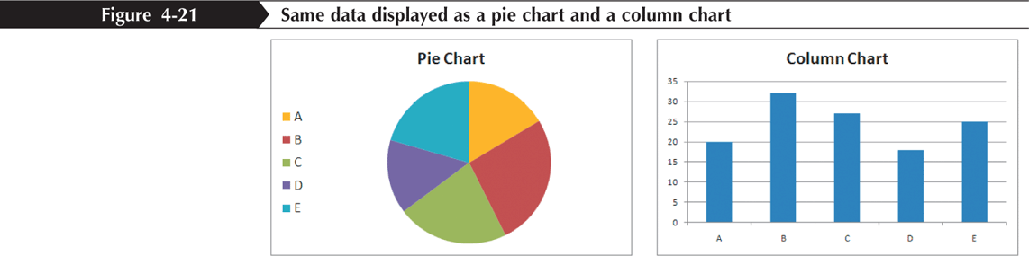
Creating a Column Chart
A column chart displays values in different categories as columns; the height of each column is based on its value
The bar chart is a column chart turned on its side, so each bar length is based on its value

Slide 19
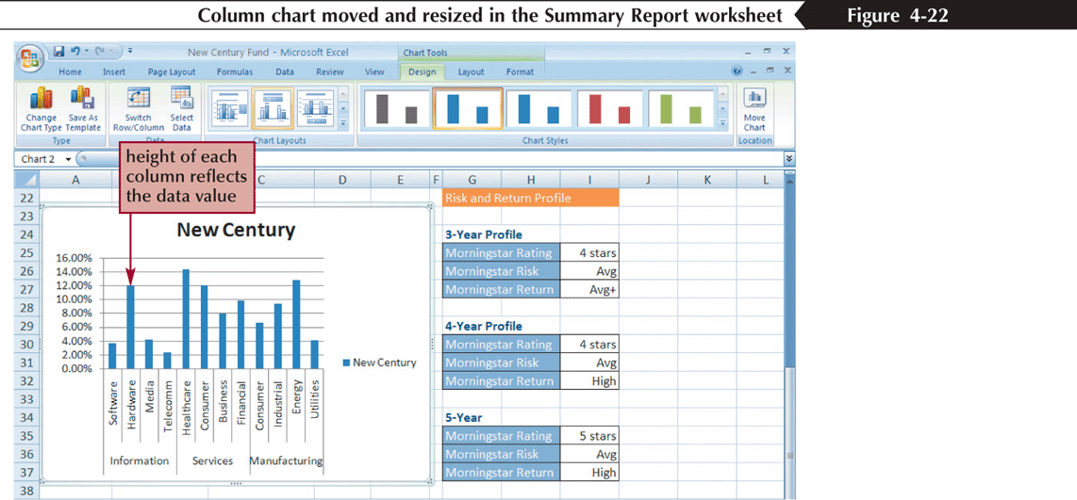
Creating a Column Chart
Select the range
Click the Insert tab on the Ribbon
In the Charts group, click the Column button and then choose the chart subtype

Slide 20
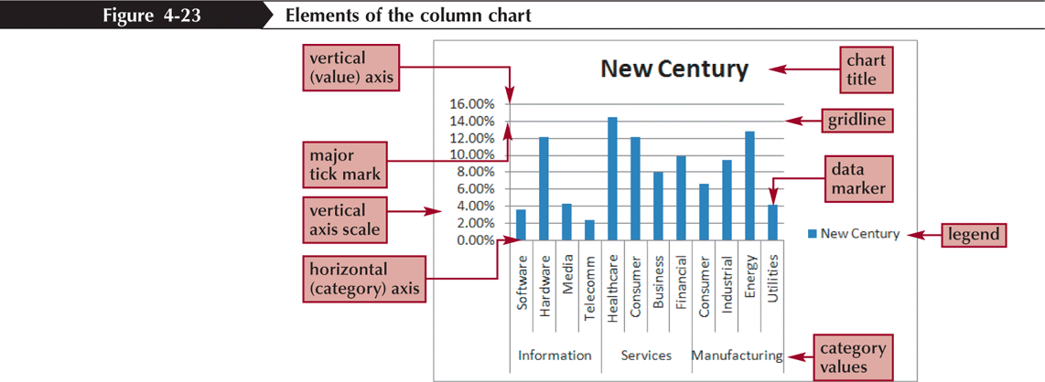
Formatting Column Chart Elements
Click the Chart Tools Layout tab on the Ribbon

Slide 21
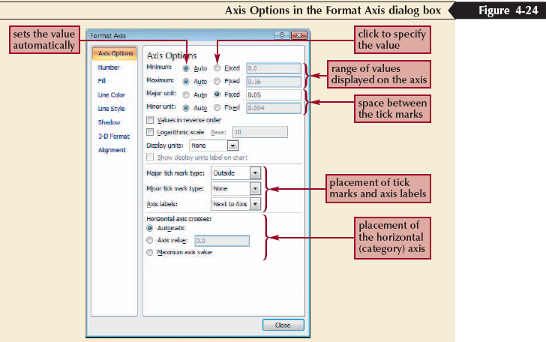
Formatting the Chart Axes
Click the Chart Tools Layout tab on the Ribbon

Slide 22
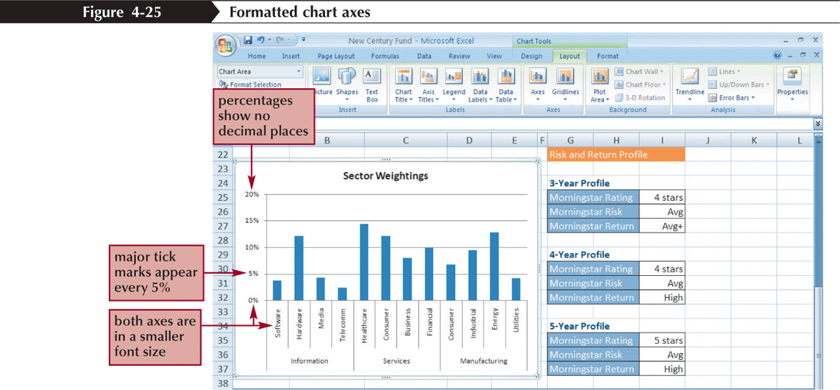
Formatting the Chart Axes

Slide 23
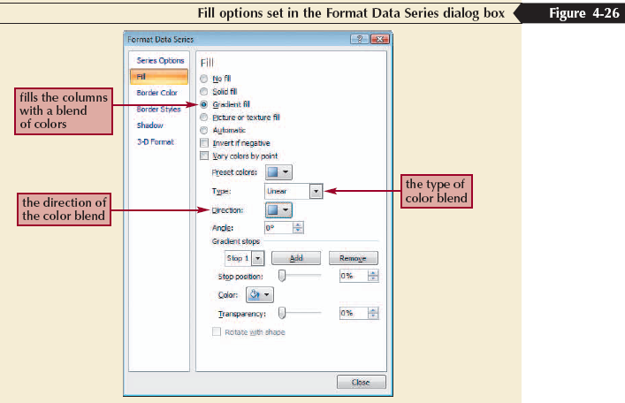
Formatting Chart Columns
Click any column in the Sector Weightings chart
In the Current Selection group on the Chart Tools Layout tab, click Format Selection

Slide 24
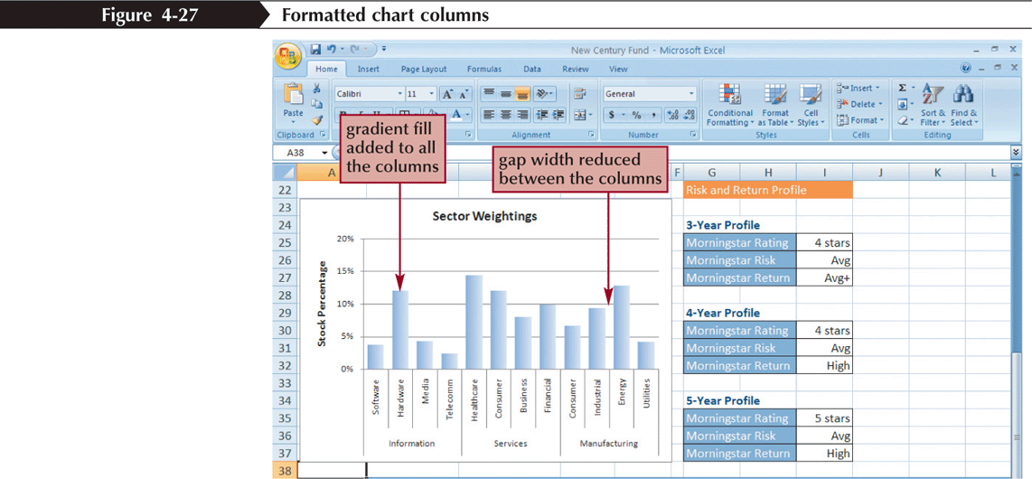
Formatting Chart Columns

Slide 25
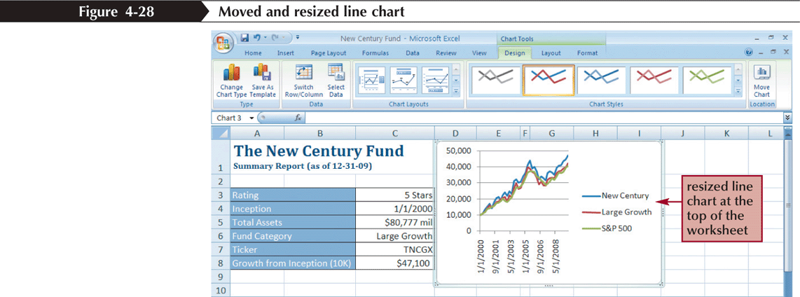
Creating a Line Chart
Select the range
Click the Insert tab on the Ribbon
In the Charts group, click the Line button, and then click the Line chart

Slide 26
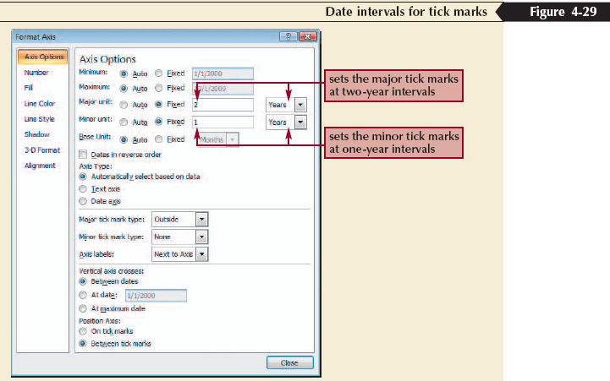
Formatting Date Labels
Click the Chart Tools Layout tab on the Ribbon
In the Axes group, click the Axes button, point to Primary Horizontal Axis, and then click More Primary Horizontal Axis Options

Slide 27
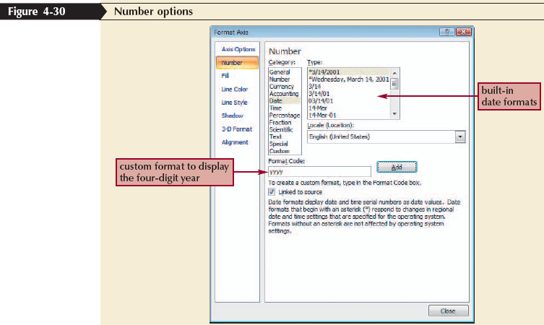
Formatting Date Labels

Slide 28
Setting Label Units
In the Axes group on the Chart Tools Layout tab, click the Axes button, point to Primary Vertical Axis, and then click More Primary Vertical Axis Options
Click the Display units arrow and then make your selection

Slide 29
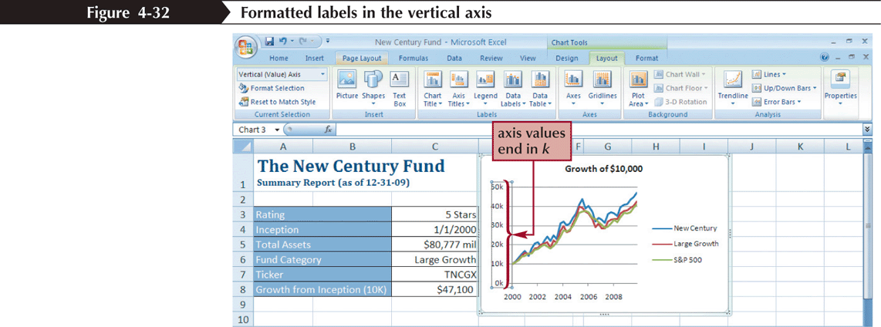
Setting Label Units

Slide 30
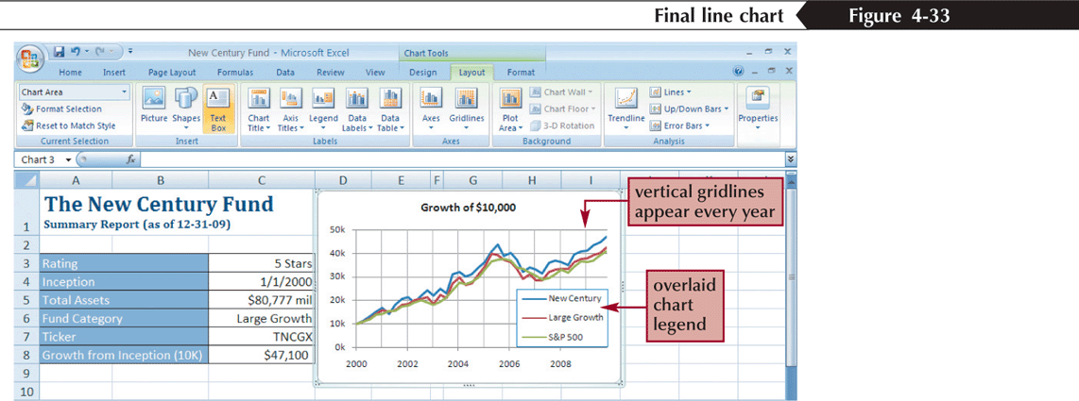
Overlaying a Legend
In the Labels group on the Chart Tools Layout tab, click the Legend button, and then click More Legend Options
Click the Show the legend without overlapping the chart check box to remove the check mark

Slide 31
Adding a Data Series to an Existing Chart
Select the chart to which you want to add a data series
In the Data group on the Chart Tools Design tab, click the Select Data button
Click the Add button in the Select Data Source dialog box
Select the range with the series name and series values you want for the new data series
Click the OK button in each dialog box

Slide 32
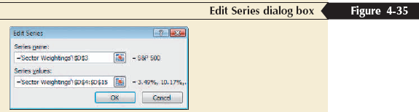
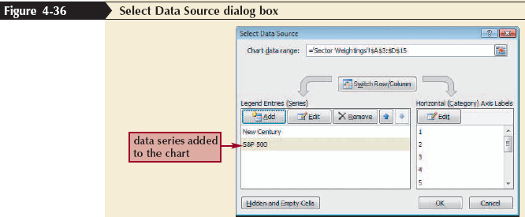
Adding a Data Series to an Existing Chart

Slide 33
Creating a Combination Chart
Select a data series in an existing chart that you want to appear as another chart type
In the Type group on the Chart Tools Design tab, click the Change Chart Type button, and then click the chart type you want
Click the OK button

Slide 34
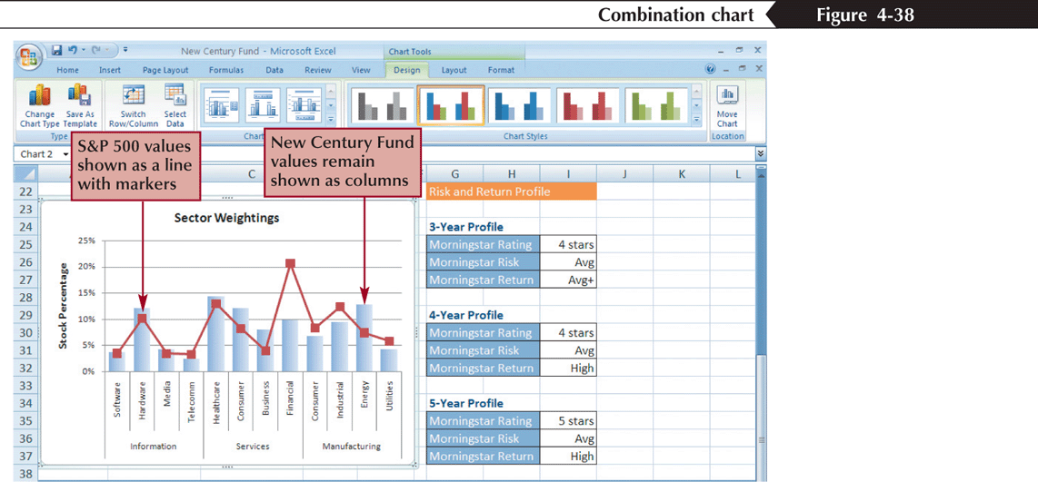
Creating a Combination Chart

Slide 35
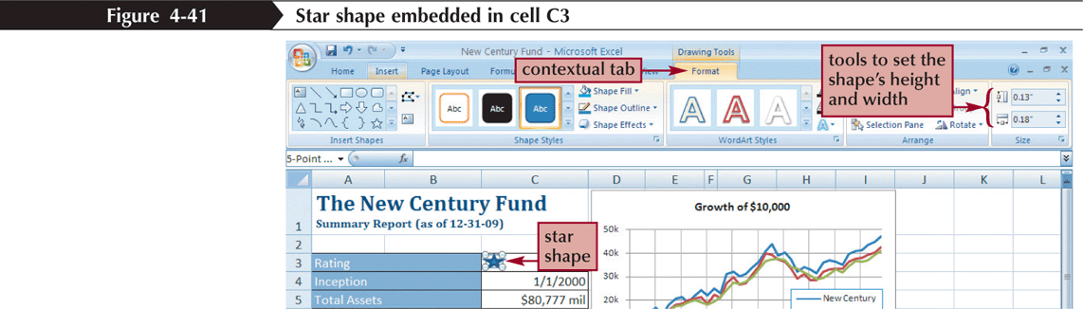
Inserting a Shape
Click the Insert tab on the Ribbon
In the Illustrations group, click the Shapes button, and then choose the shape you want
Draw the shape in your worksheet

Slide 36
Aligning and Grouping Shapes
Hold down the Shift key and then click each shape to select it
Click the Drawing Tools Format tab on the Ribbon
In the Arrange group, click the Align button, and then click your alignment option
To group several shapes into a single unit, select the shapes, and then click the Group button in the Arrange group on the Drawing Tools Format tab

Slide 37
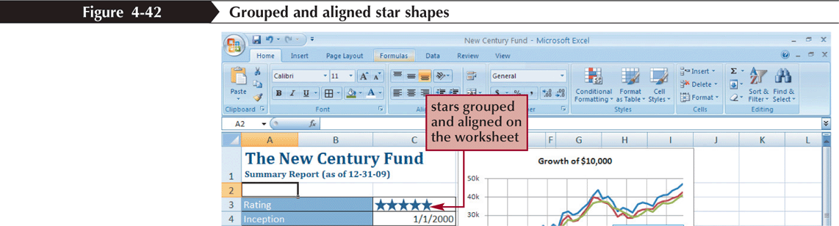
Aligning and Grouping Shapes

